Slide 1
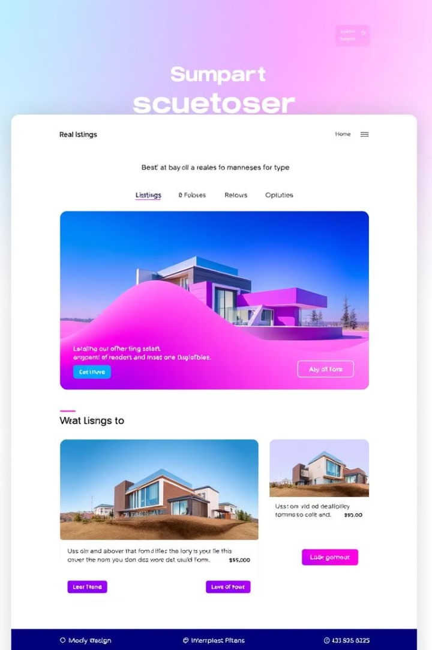
EstateVista: Revolutionizing Real Estate
EstateVista is a cutting-edge real estate platform, leveraging the power to deliver an intuitive and comprehensive user experience. It aims to simplify the process of buying, selling, and renting properties, connecting buyers and sellers in a seamless and efficient manner.

Slide 2
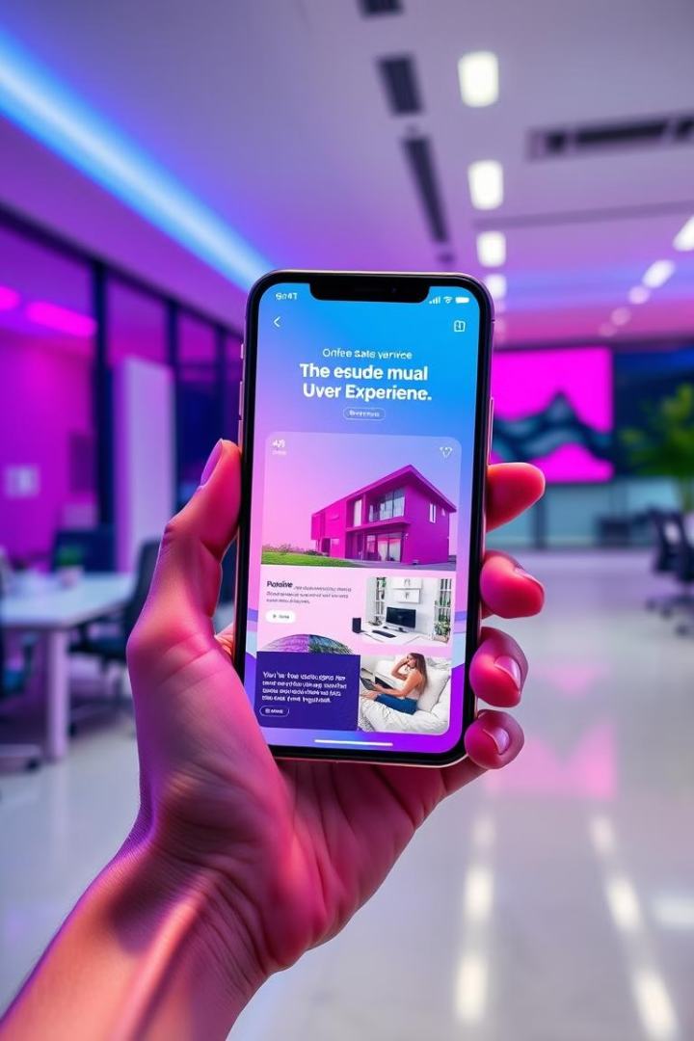

Project Overview
1
Real Estate Platform
2
MERN Stack Development
EstateVista is a user-friendly platform for property listings, connecting buyers and sellers.
The platform is built using MongoDB, Express.js, React.js, and Node.js.
3
Interactive Features
4
Seamless User Experience
EstateVista offers advanced features like property search, add booking, add fav
The platform is designed to provide a smooth and intuitive experience for both buyers and sellers.

Slide 3
Goals and Objectives
User-Centric Design
Comprehensive Listings
Efficient Search and Filtering
Creating an intuitive and easy-to-use interface for users of all technical levels.
Providing a wide range of property options with detailed information and high-quality images.
Enabling users to quickly find properties that meet their specific requirements.

Slide 4




Alignment with UN Sustainable Development Goals
Sustainable Cities and Communities
Promoting sustainable housing practices and facilitating efficient property transactions.
Reduced Inequalities
Providing access to affordable and equitable housing options for all.
Innovation and Infrastructure
Leveraging technology to enhance the real estate industry and create a more efficient system.

Slide 5

Methodology and Approach
1
Requirement Gathering
Conducting thorough market research and user feedback to understand the needs and preferences of potential users.
2
Design and Development
Implementing a user-centered design approach, using the MERN stack to build a robust and scalable platform.
3
Testing and Deployment
Rigorous testing to ensure functionality, security, and performance before launching the platform.

Slide 6

Expected Outcomes and Impact
Enhanced User Experience
Improved efficiency and convenience for buyers, sellers, and renters.
Increased Property Visibility
More exposure for property listings, leading to faster sales and rentals.
Greater Market Transparency
Providing comprehensive property data and insights, empowering informed decisions.
Sustainable Real Estate Practices
Promoting responsible and environmentally conscious property transactions.

Slide 7




Allows users to save and revisit preferred listings.
Value: Enhances engagement and simplifies decision-making.
Key Project Deliverables
Advanced Search and Filters
Enables users to find properties by location, price, and type with ease.
Provides a fast, personalized browsing experience.
Favorites and Wishlist
Allow user to save and visit the preferred listing
Enhance the engagement and simplify decision making
Secure Booking with auth 0
Allow the secure authorization using the auth0 it protect the
User data and builds the trusts

Slide 8

Next Steps and Conclusion
The next step is to finalize the platform's development, implement rigorous testing, and launch EstateVista to the public. Further we are deciding to add some more modules and convert this in the major project

